Slide 1
TourGo
Jemil Gambo and Declan Moore

Slide 2
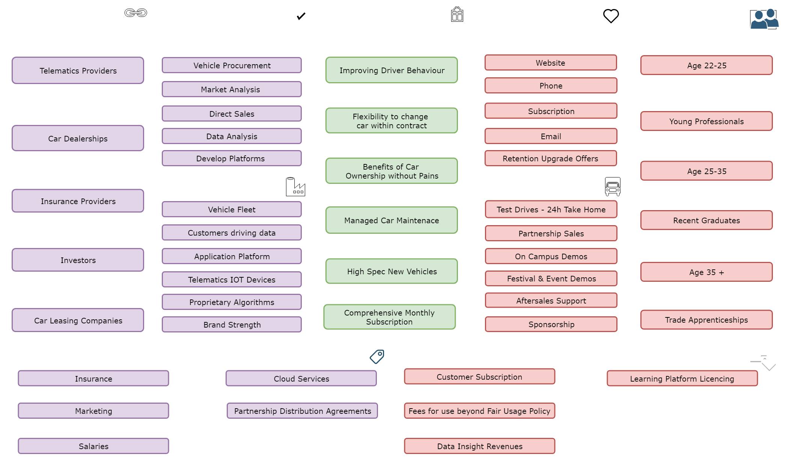
Business Model Canvas

Slide 3
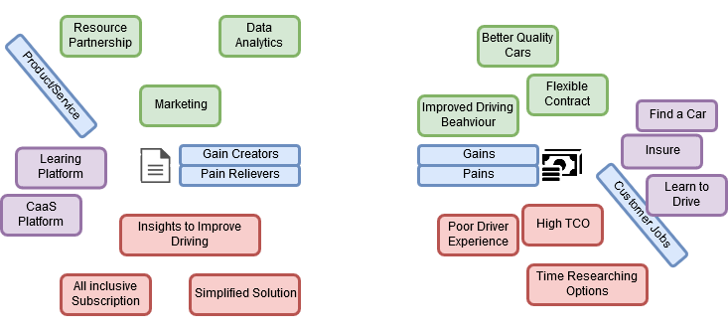
Value Proposition Canvas

Slide 4
Financial Projections
Year 1 | Year 3 | Average Customer | Future
25 Customers | 1000 Customers | Spends €300-400/month | Expand Fleet
€50,000 in Revenue | €2,000,000 in Revenue | €4,880/annum revenue | Include EVs in Fleet
Compact Fleet: 1L Petrol | Additional Fleet Streams | 2 year contract | Improve Learning Platform
 |  |  | Increase Range of Vehicles
 |  |  | Flexible Car Swapping
 |  |  | Bronze, Silver, & Gold Policies

Slide 5
Market Analysis
Problems in the Market
Market Potential
Upfront cost of driving €6,000-7,000*.
House Price Increase 57%*.
Problems in driving education:
58% of people took test 2-3 times before passing*.
40% of people think 12 lessons is not enough*.
Public Transport usage to increase by 10% in 2019.
Additional delays.
Un-serviced Routes.
*Figures from Census, SIMI, Carzone, Independent.ie, Market Analysis
Over 1 million potential customers*.
Insurance set to decline by 20% by 2020*.
EU aims to reduce emissions by 20% for 2020*.
Government grants for Electric Vehicles.
50% of car buyers will buy a car 2 years or younger*.
TourGo only offer cars within this age range.

Slide 6
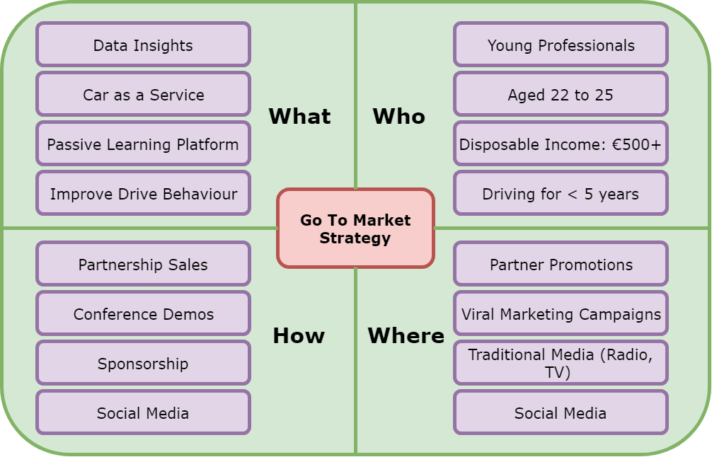
Marketing Strategy

Slide 7
Thank You

